Slide 1
Parker Lewis Research: 11/20; towerslope updates

Slide 2
L-3 Data Outline:
Logscale properties of pl (stat err measurements) for 1 million, 0.75 shift factor (** Most statistics and decal shift will have same log scale properties will show later **)
RMS and Statistical error measurements results and properties.

Slide 3
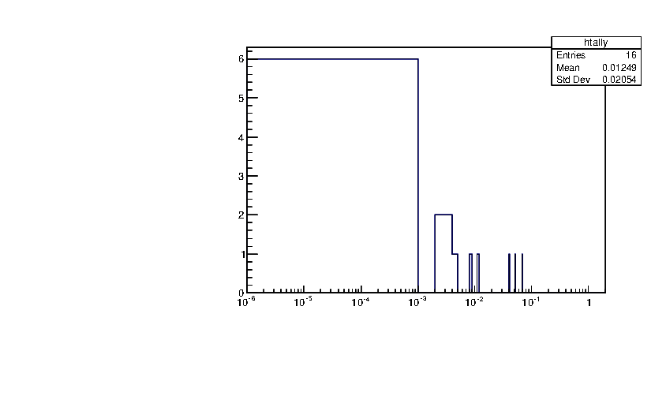
Log Scale Example Plot (l3)
Log Scale is read from 10^-6, 10^-5, etc tick marks.
Bin Size = Total Range/Number of Bins : approx. 10^-3
An individual stat error measurements order of mag is what tells the simulation where to fill in log scale.
6 measurements within: 10^-6 to 10^-5; 8 measurements within 10^-3 to 10^-1
Question for Research: Do all statistics follow this pattern, is their ways to make stat errors more within same range and does it matter for tower slope method?
Sidemark: Error distribution distribution properties. (Look: Root Primer; Num recipes, physics stackexchange)
Chi square connections for this

Slide 4
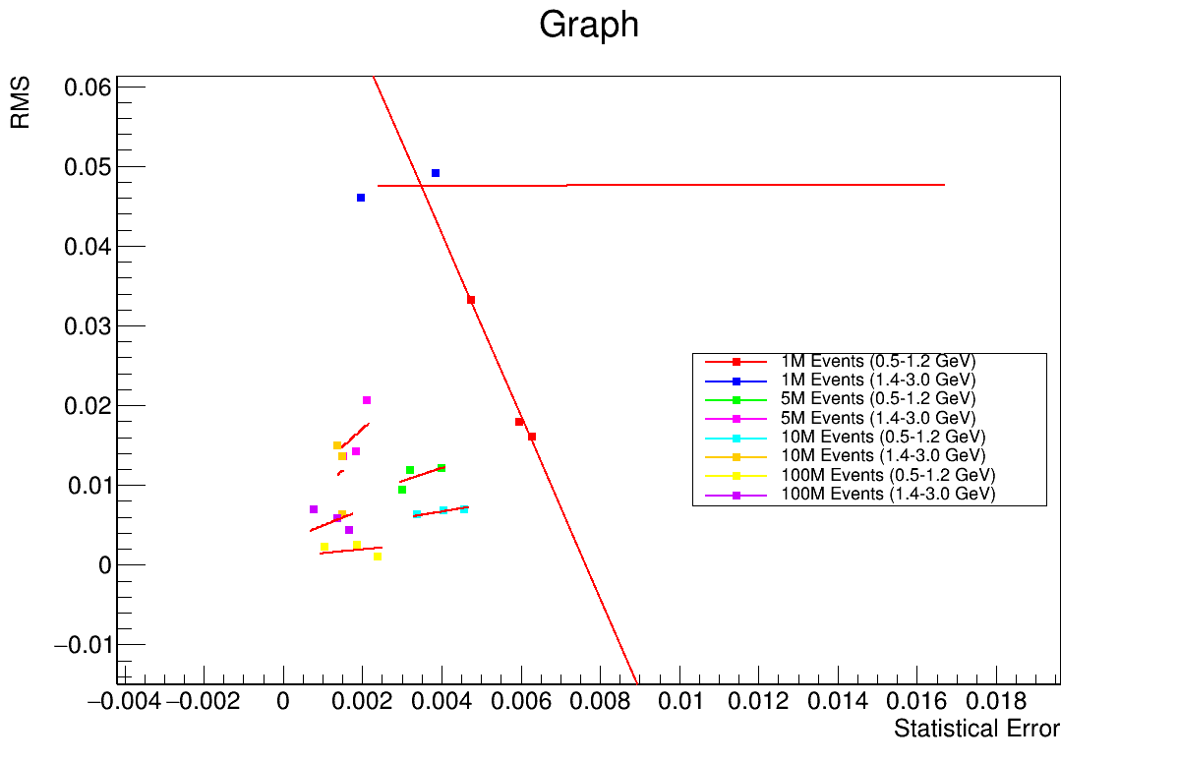
RMS Vs. Stat error Plot (l3)
There is clear correlation within all linear fits of RMS and stat error.
1 mill: Low Pt RMS dec then Stat error increases less linear increase for high pt RMS approx. same for stat error increase.
5-10 mill: stat error within each point 0 to 0.008 and RMS 0 to 0.003. Shows same order of magnitude.
Low pt (5m-10m) Rms less compared to high pt. vice versa with stat error.
This may be clear enough to conclude RMS dependence on stat error.
Plot Low Pt(Separate) RMS vs. Mean Stat error.
Plot RMS vs. Max. (uniform art error: Size Order of Spread)

Slide 5
Conclude Fall 2024
Final Research update of analysis of all results and display all properties and test knowledge of Tower slope and SPHENIX. (DO PRESENTATTION) (END OF SEMESTER)
DO all studies for Rebinning to see if same properties are noticed.
Get correlation/correlation type plot of RMS and Stat error this maybe useful look into this **.
Answer Questions I have for this meeting as well.
START WRITING SOON.
Refine Answer: Why RMS/Stat error matter.
Individual/Combined Exp and L3 stat error RMS plot.

Slide 6
How to access data: (my Github)
https://github.com/plewis3323/Master_w

